Slide 1
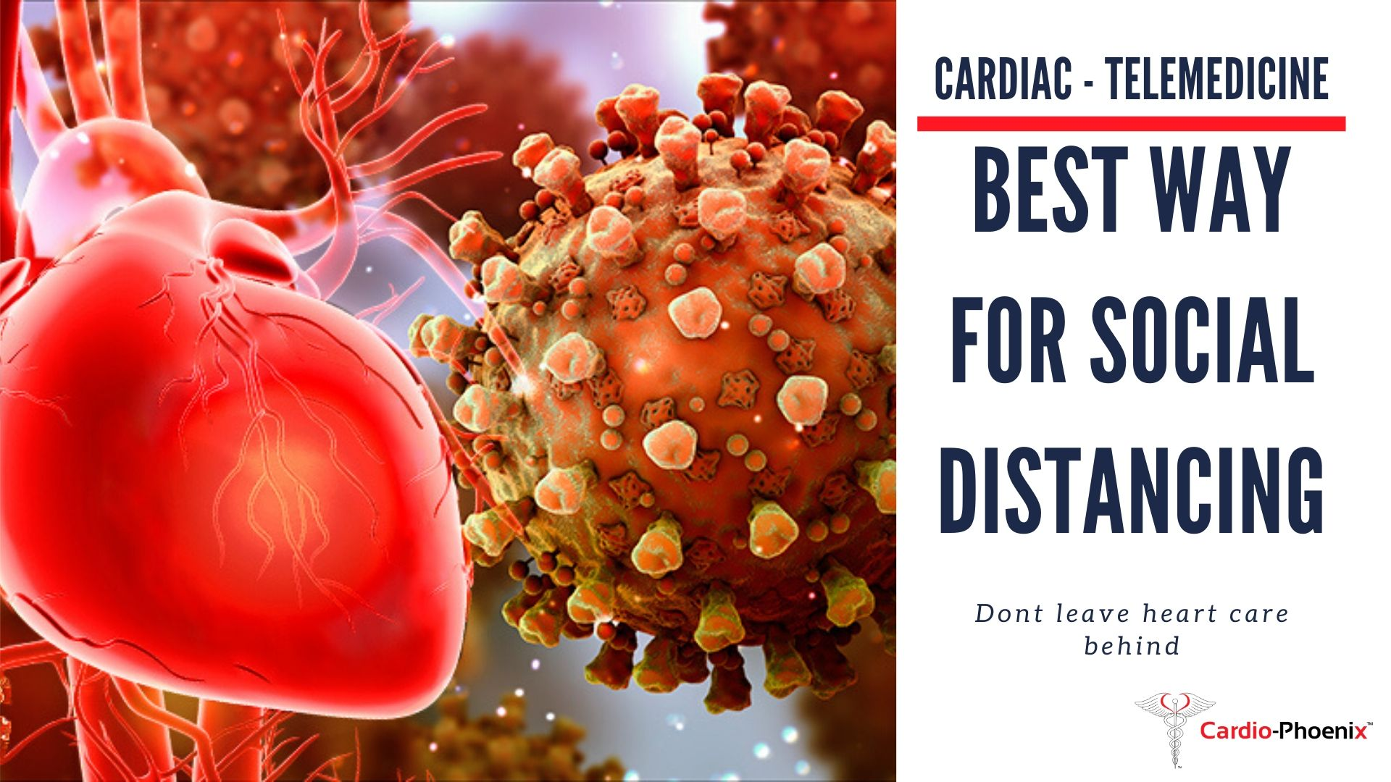
COVID-19 AND CARDIOVASCULAR SYSTEM
DEPT OF CARDIOLOGY
GMCH KOZHIKODE

Slide 3
TAXONOMY
Delta
Coronavirus

Slide 4
HUMAN CORONAVIRUSES
SPECIES | DISEASE | RECEPTOR
Alphacoronavirus
HCoV-229E | Common cold | Human aminopeptidase N
HCoV-NL63 | Mod-to-sev URTI/LRTI, croup | Angiotensin-converting enzyme 2
Betacoronavirus
HCoV-OC43 | Common cold | N-acetyl-9-O-acetylneuraminic acid
HCoV-HKU1 | Both URTI/LRTI | O-Acetylated Sialic Acid
SARS-CoV | SARS | Angiotensin-converting enzyme 2 Human CD209L
MERS-CoV | “Camel-flu” | DPP4 (Di Peptidyl Peptidase 4)
Gammacoronavirus and Deltacoronavirus – no human pathogen

Slide 5
HUMAN CORONAVIRUSES
Sporadic/ Seasonal
HCoV-229 E
HCoV-OC 43
Outbreaks/ Epidemics
SARS-CoV
MERS-CoV
HCoV-NL 63
HCoV-HKU 1
Novel Coronavirus (SARS-CoV-2)

Slide 6
Virus Entry

Slide 9
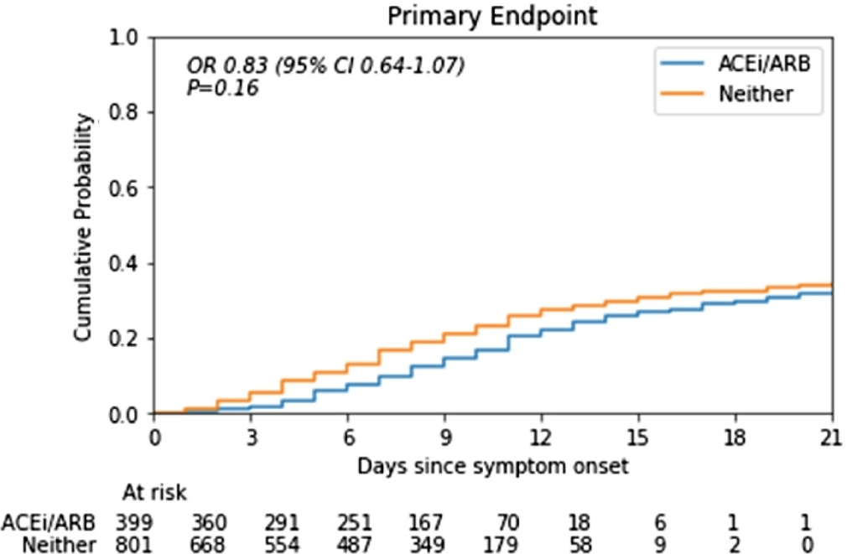
(Death/ICU Admission)
Notes:
Ehj 2/6
1200 pts
Death or icu admission

Slide 12
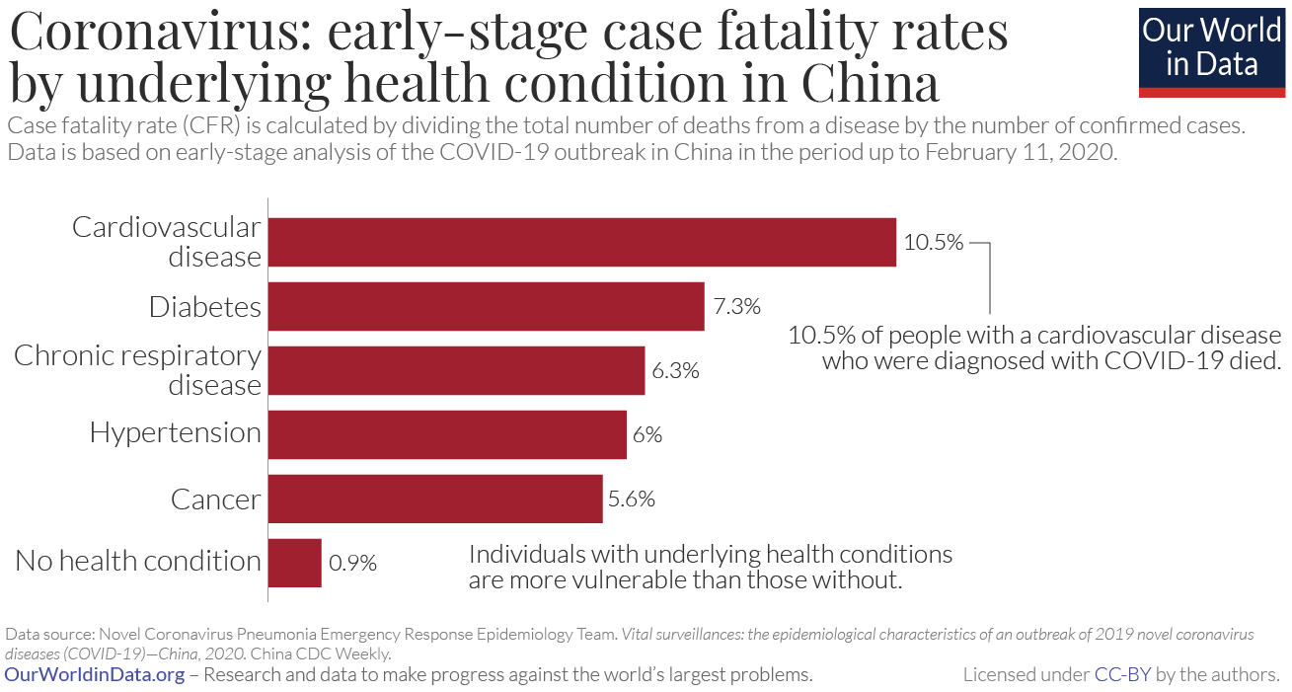

Slide 13
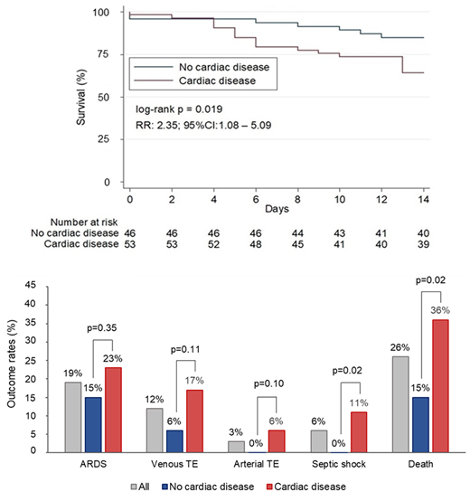
Notes:
Italy
Pneumonia pts
w

Slide 15
Who are at risk of severe illness?
Post cardiac transplant
Heart failure
CAD
Congenital cyanotic heart disease
Elderly/malignancy/pregnancy with CVD
HOCM
Brugada syndrome
Arrhythmias
Valvular heart disease

Slide 16
Predictors of in-hospital death

Slide 17
COVID 19 Implications For CVD Patients
Best treatment is prevention
Every measures to prevent infection
Strict adherence to medication and lifestyle measures
Promote telehealth programs
Elective procedures can be delayed
Early testing and admission in case of COVID 19 symptoms

Slide 19
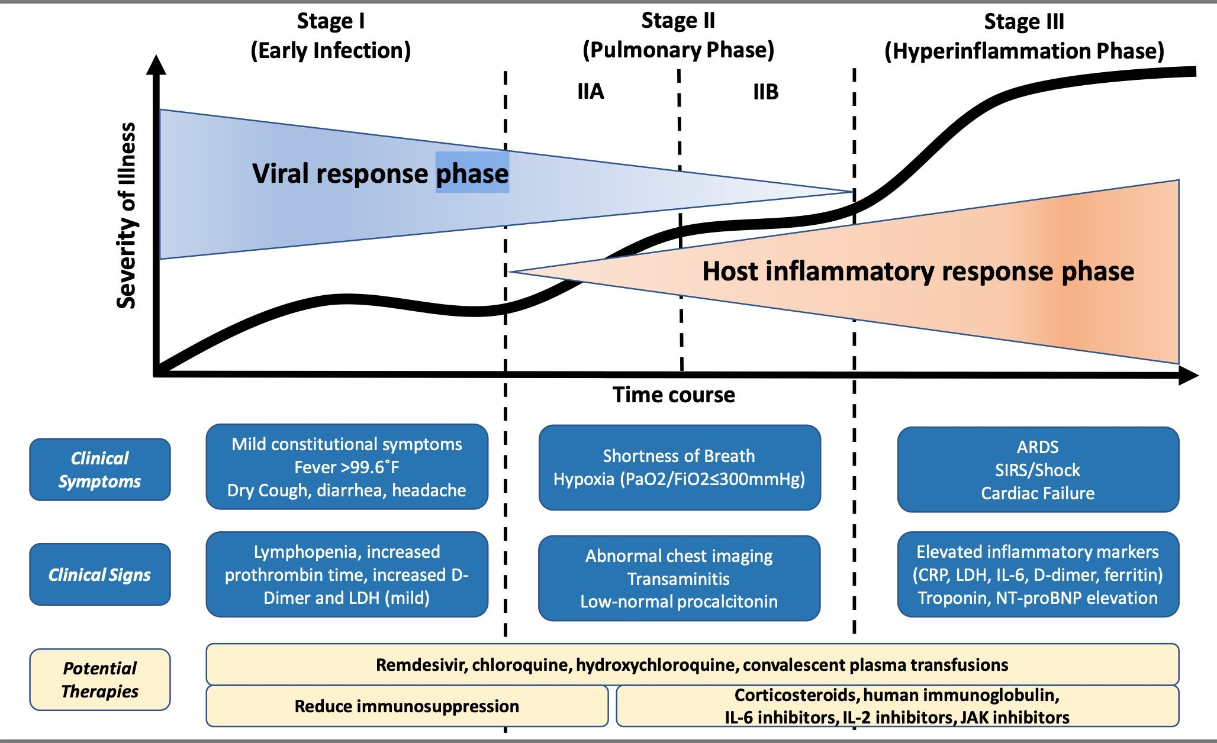

Slide 21
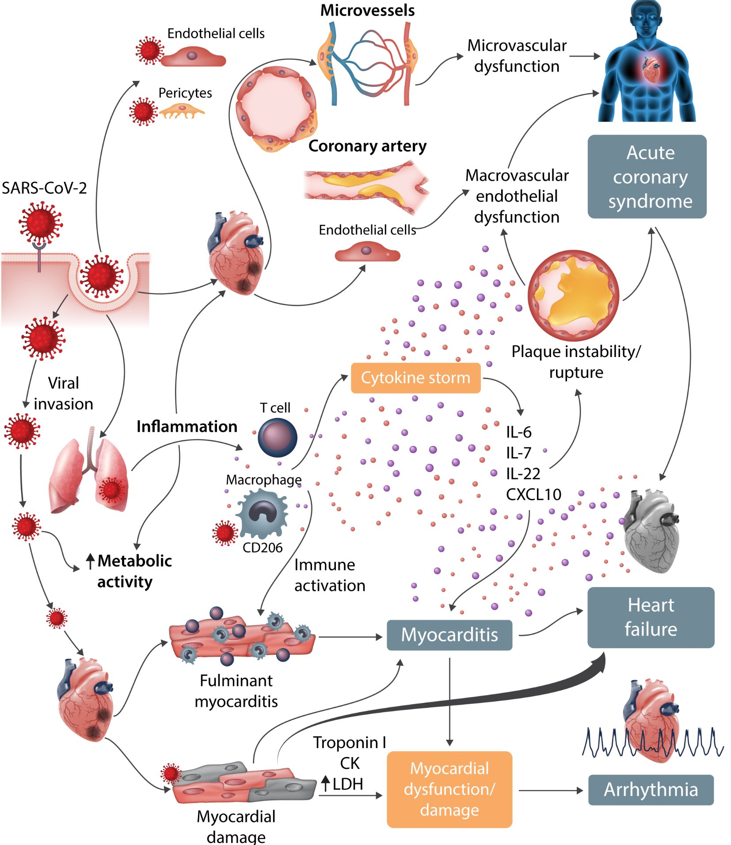
Notes:
Toci-il6

Slide 22
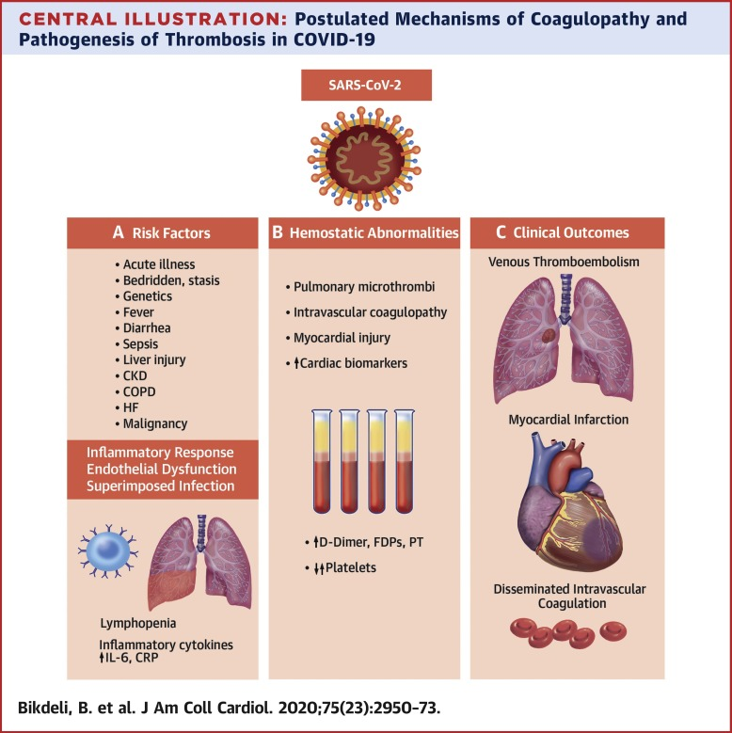

Slide 27
Notes:
Rule out tako and myocarditis

Slide 28
Myocarditis vs MI
Echocardiography-pattern
Consider type 2 MI
Start on Aspirin and Heparin
Monitor progress

Slide 29
NSTEMI and UA
Prefer medical management
Start on GDMT
Don’t start on ACEi/ARB
Plan revascularisation later

Slide 30
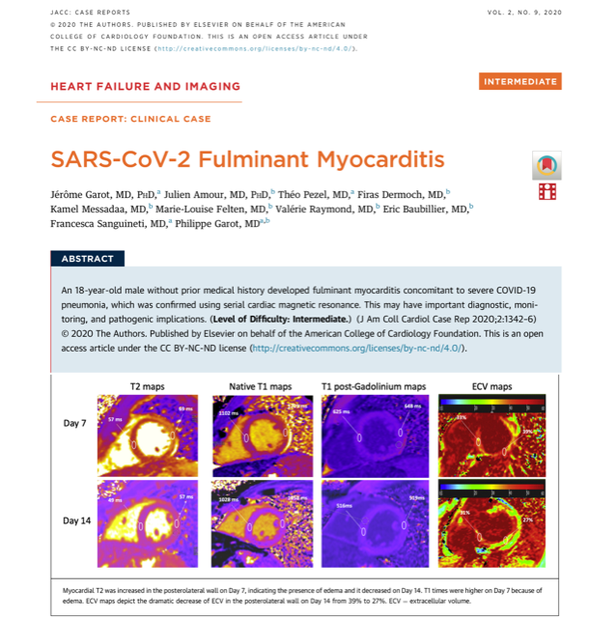

Slide 31
Fulminant Myocarditis
Rare complication
Mimics ACS
Affects young people
High mortality
No established therapy except HF management
Steroid and IVIG may be useful

Slide 32
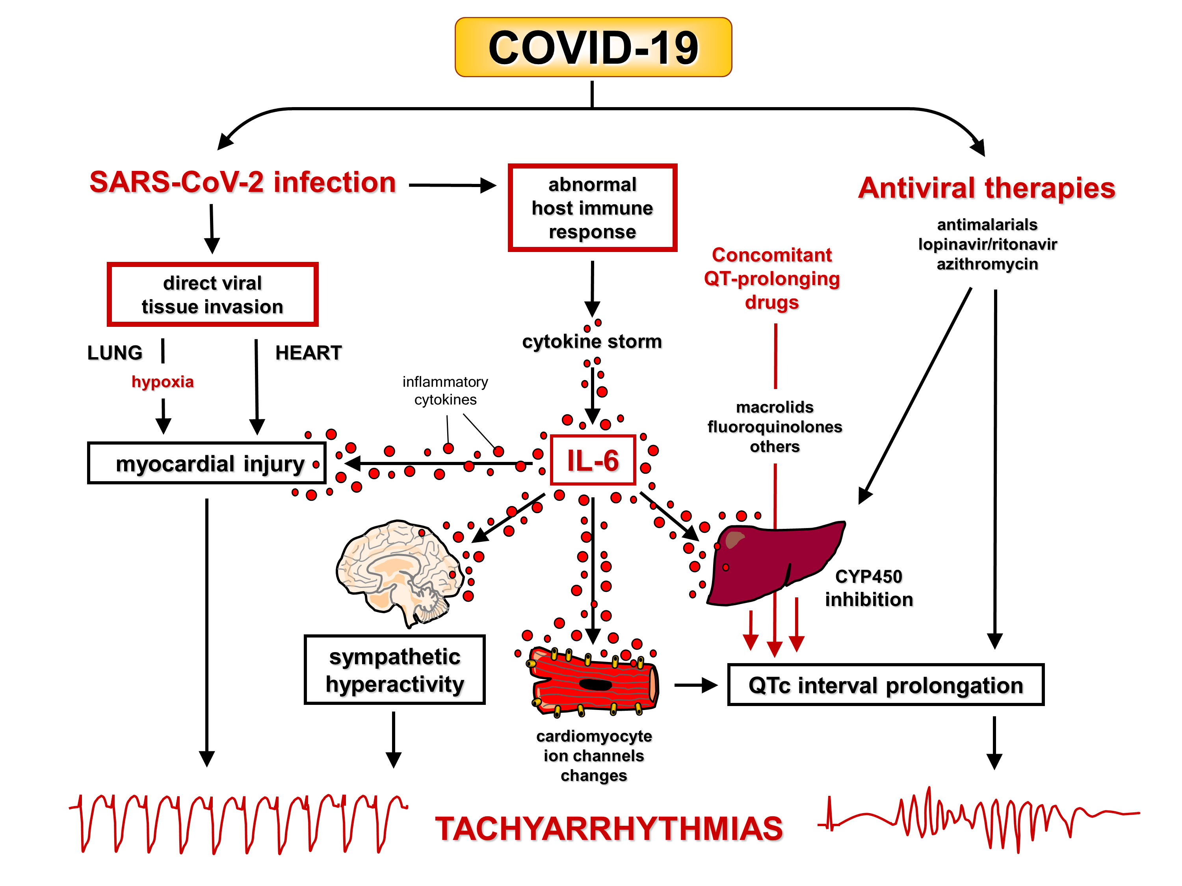

Slide 33
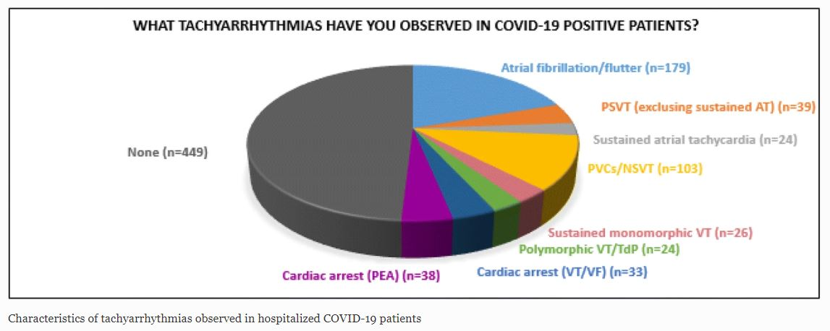

Slide 34
DVT In Ventilated Patients
Notes:
10days and 14days after sypmtom

Slide 36
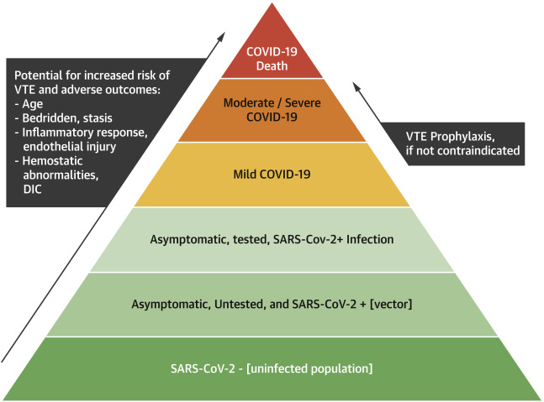

Slide 38
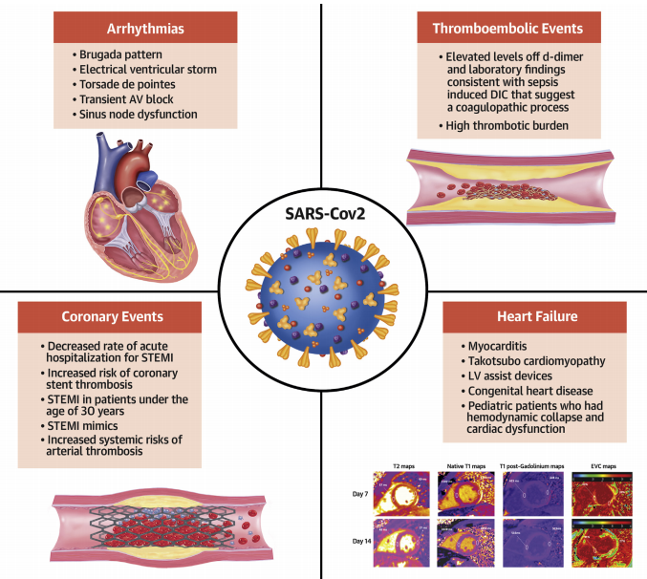
Notes:
Tako-4x rise

Slide 39
Drug options for COVID-19 patients with CVD
Antiplatelets/OAC: continue medication and watch for bleeding
Statins: monitor LFT
ACEi/ARB/ARNI: don’t start or stop
Beta blockers: continue in the absence of hypoxia, airway spasm or shock
Diuretics: continue and avoid dehydration

Slide 42
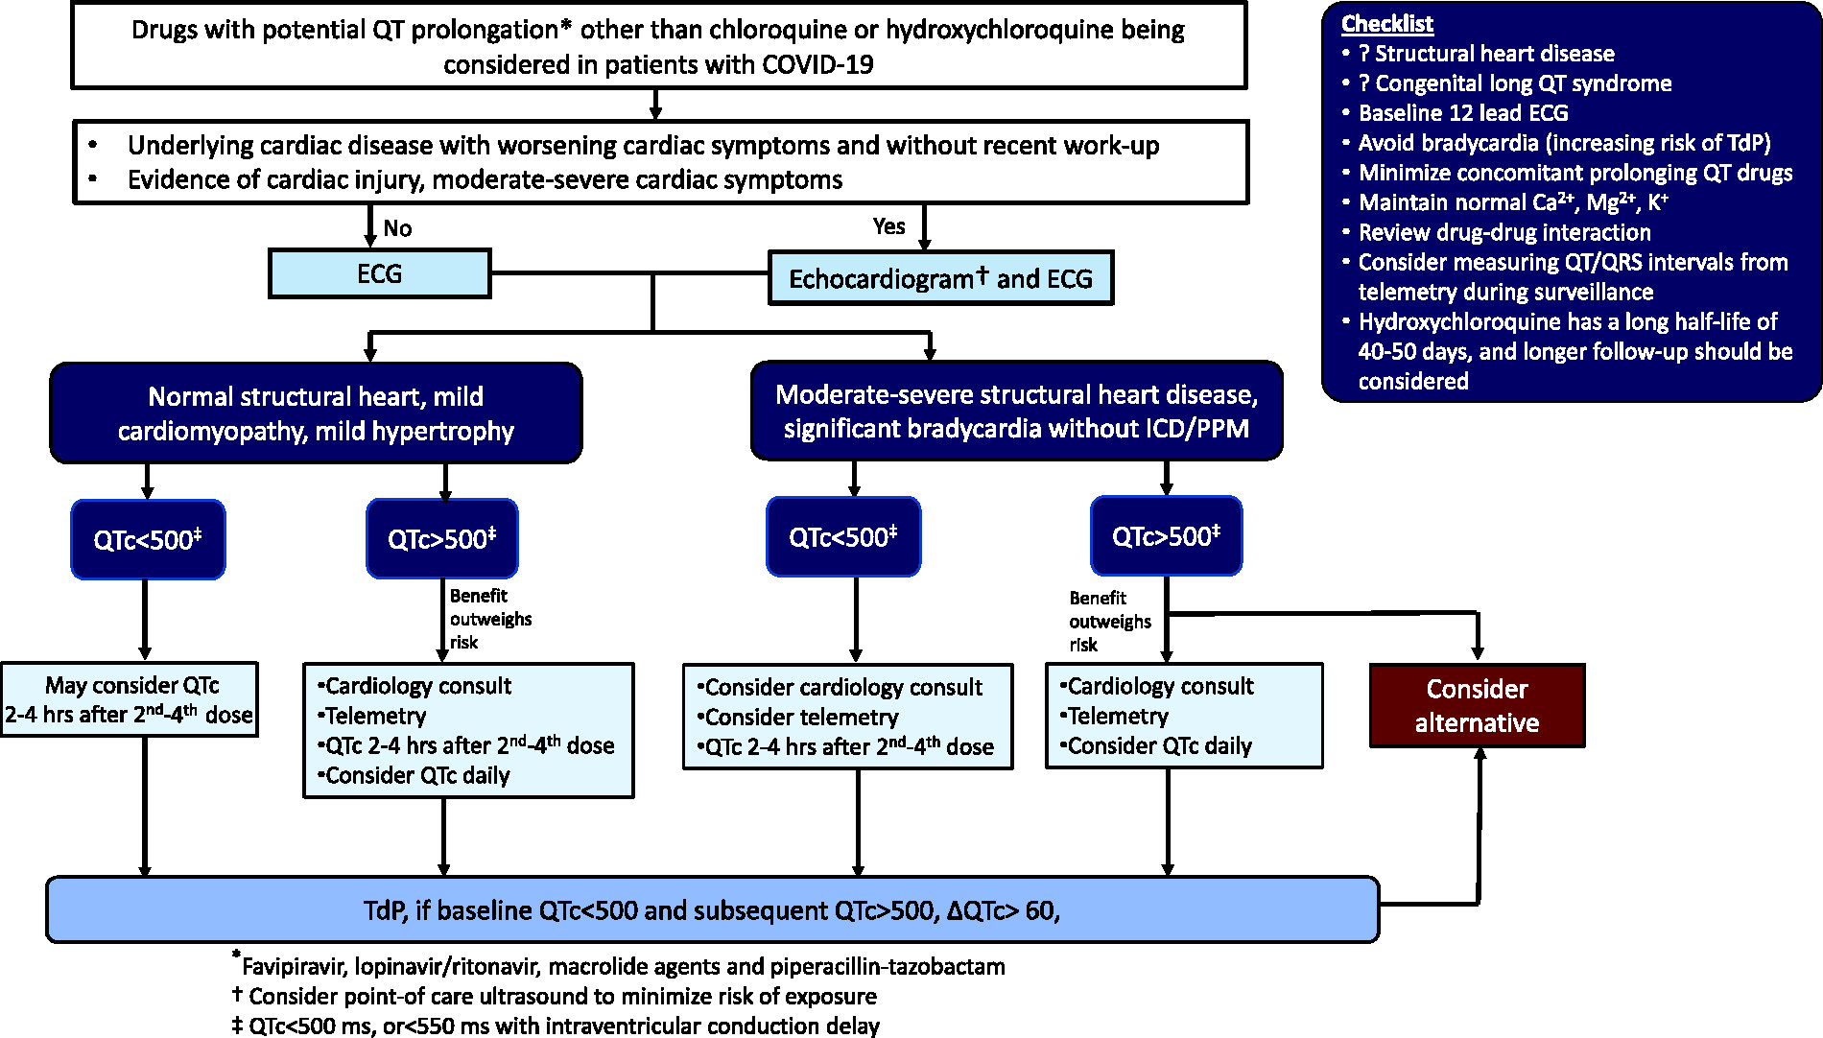

Slide 44
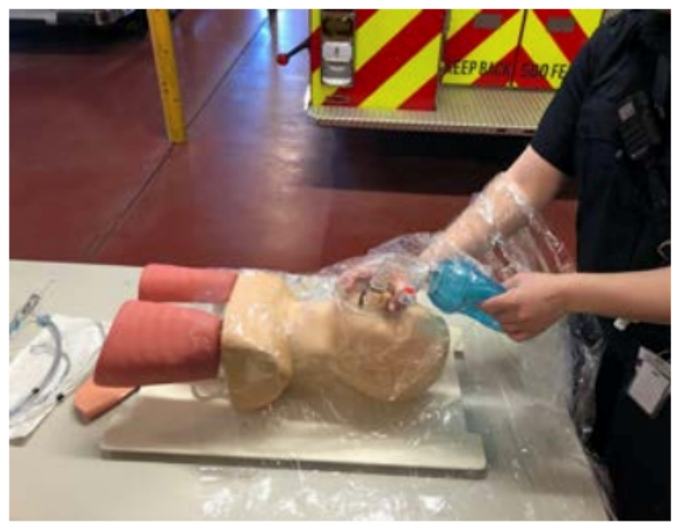
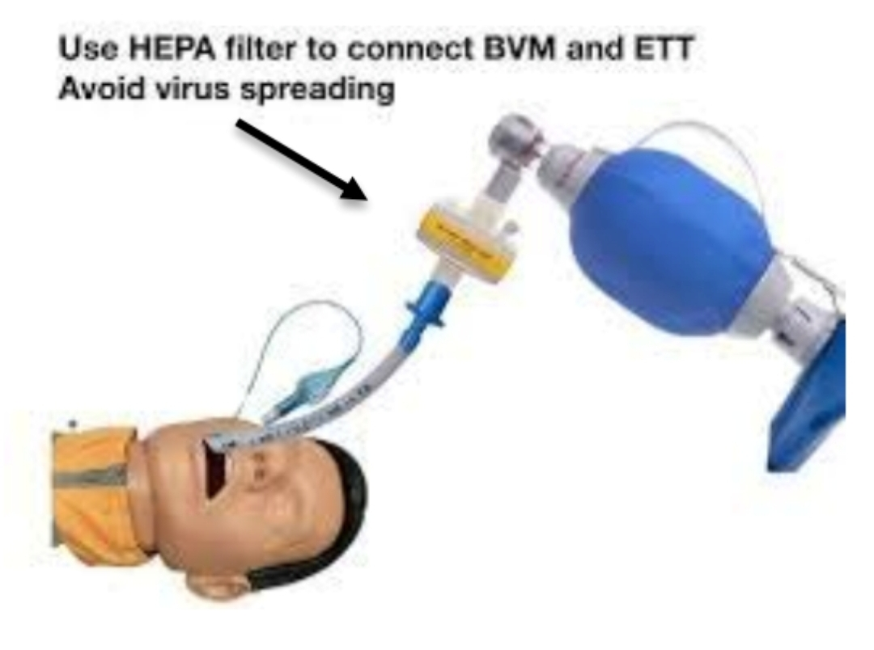
CPR
Consider appropriateness
Don PPE
Limit personnel
Limit aerosolization risk
Use HEPA filter
Mechanical CPR devices if available

Slide 45
COVID Impact In Routine Care
Late presentation of MI
Drug default – stent and mechanical valve thrombosis
Increased incidence of stress cardiomyopathy
Increased out of hospital cardiac arrest
Delay in elective procedures
Reduced access to health care
Increased mental stress and physical inactivity

Slide 47
Take Home Message
Underlying cardiac condition is a strong mortality predictor
Intensive preventive measures should be followed in this group
Cardiovascular involvement has a significant impact on prognosis
D-dimer value based anticoagulation may be considered
Don’t stop or start ACEi/ARBs
Monitor for cardiotoxicity of medications
HF and pneumonia should be differentiated and treated accordingly
Never ever underestimate preventive measures
Promote indoor physical activity
Never ignore chest pain

Slide 49
Thank You

